Slide 1
GRIDS x CKIDS Project
Worldwide Survey Estimates of Maternal Bereavement
Dr. Emily Smith-Greenaway
Aditi Singh, Asumi Suguro, Madeleine Thompson, and Malika Seth

Slide 2
The Team
Mentor: Dr. Emily Smith-Greenaway
Aditi Singh - Undergrad in Data Science
Asumi Suguro - 1st year MS in Applied Data Science
Madeleine Thompson - 1st year MS in Applied Data Science
Malika Seth - 2nd year MS in Computer Science

Slide 3
2015 Under-5 Mortality Rate
Under-5 mortality rate, 2015
(deaths per 1000 live births)
> 100
75-100
50-75
25-50
≤ 25
No data

Slide 4
Mothers’ experiences of child loss:
Tracking retrospective reports to capture cumulative experiences

Slide 5
Mothers’ experiences of child loss:
Tracking retrospective reports to capture cumulative experiences
Time

Slide 6
Generate population indicators of the total percentage of mothers who have ever lost a child

Slide 7
Generate population indicators of the total percentage of mothers who have ever lost a child

Slide 8
Motivation
Document global inequality in maternal bereavement to see how health disparities directly affect the lives and well-being of mothers.
The link between child mortality and parents’ experiences is loosely defined.
Objective: Identify the country-specific datasets available to facilitate continued research on infant mortality among women and men across the global south. This will allow Dr. Smith-Greenaway to generate maternal oriented indicators of the population prevalence of women who have ever lost a child and to perform exploratory analysis on men’s data on this topic

Slide 9
Data and resources available
Target survey - the Demographic and Health Survey (DHS) program
Public-use
493 different surveys collected between 2010 and 2018 from 168 countries.
Data characteristics
Stata data files (.DTA)
See screenshot

Slide 10
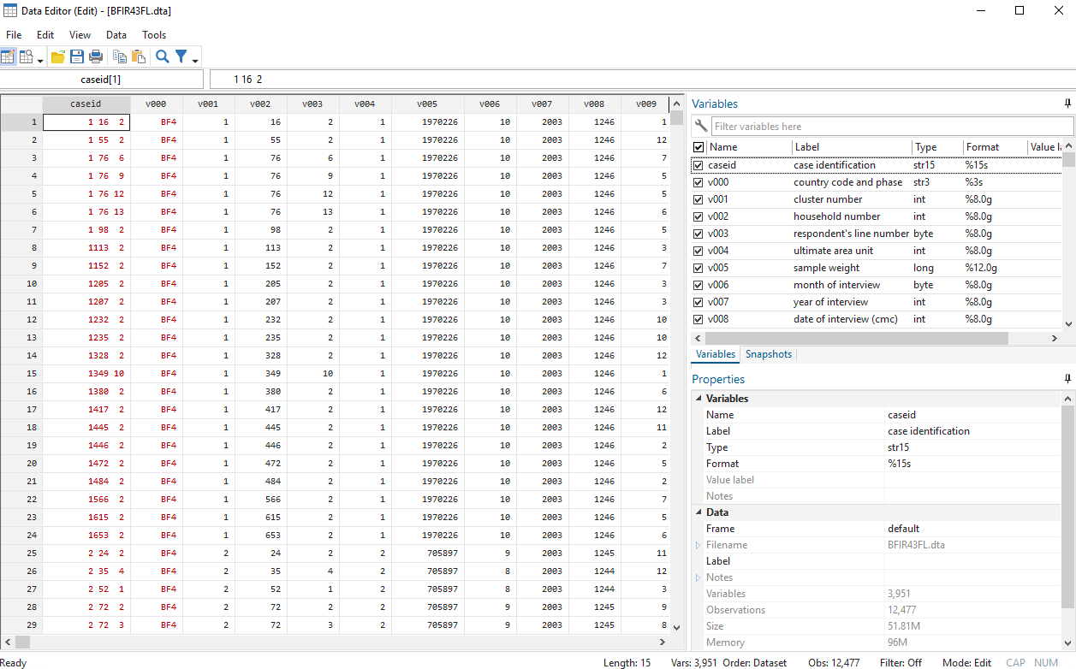
BFIR43FL.dta (3951 columns, 12,477 rows)
Notes:
As you can expect

Slide 11
Data and resources available
Challenges:
Finding target variables (include smm or mm)
Women’s recode data: 182 country-years with target variables / 304 available
Men’s recode data: 10 country-years with target variables / 189 available
Linking variables - surveys were collected with different questions so they are structured with different variable names

Slide 12
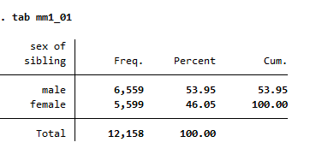
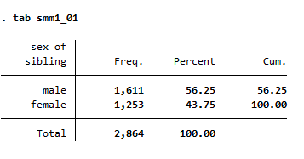


Finding Key Variables
Women’s Data
Men’s Data

Slide 13
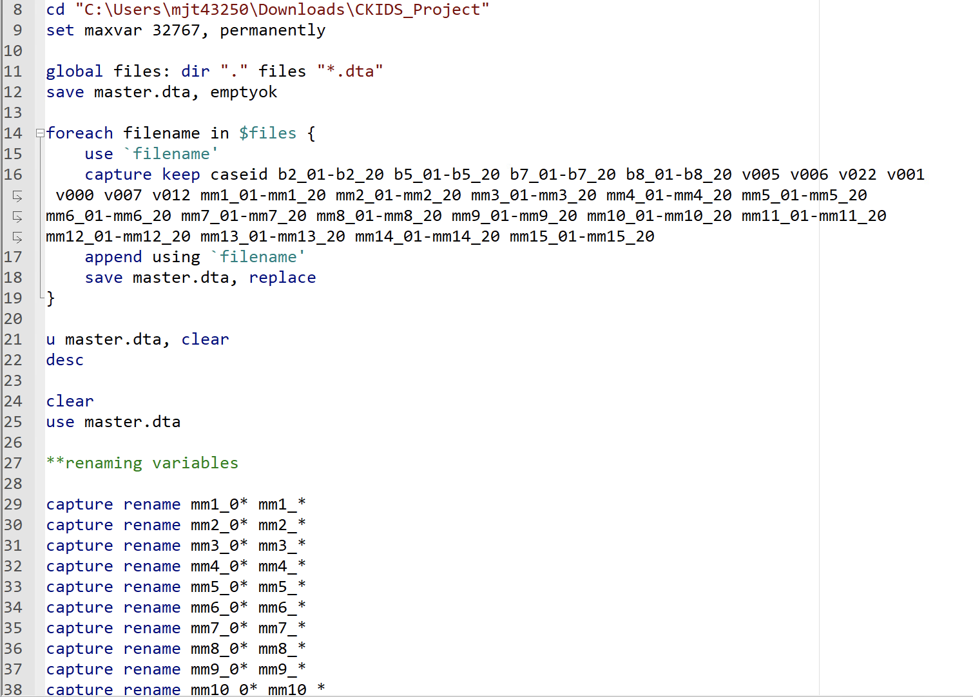
Append Datasets and Rename Variables
For each file, check if each variable in list exists. If yes, keep column.
Append dataset with desired columns.
Renaming variables

Slide 14
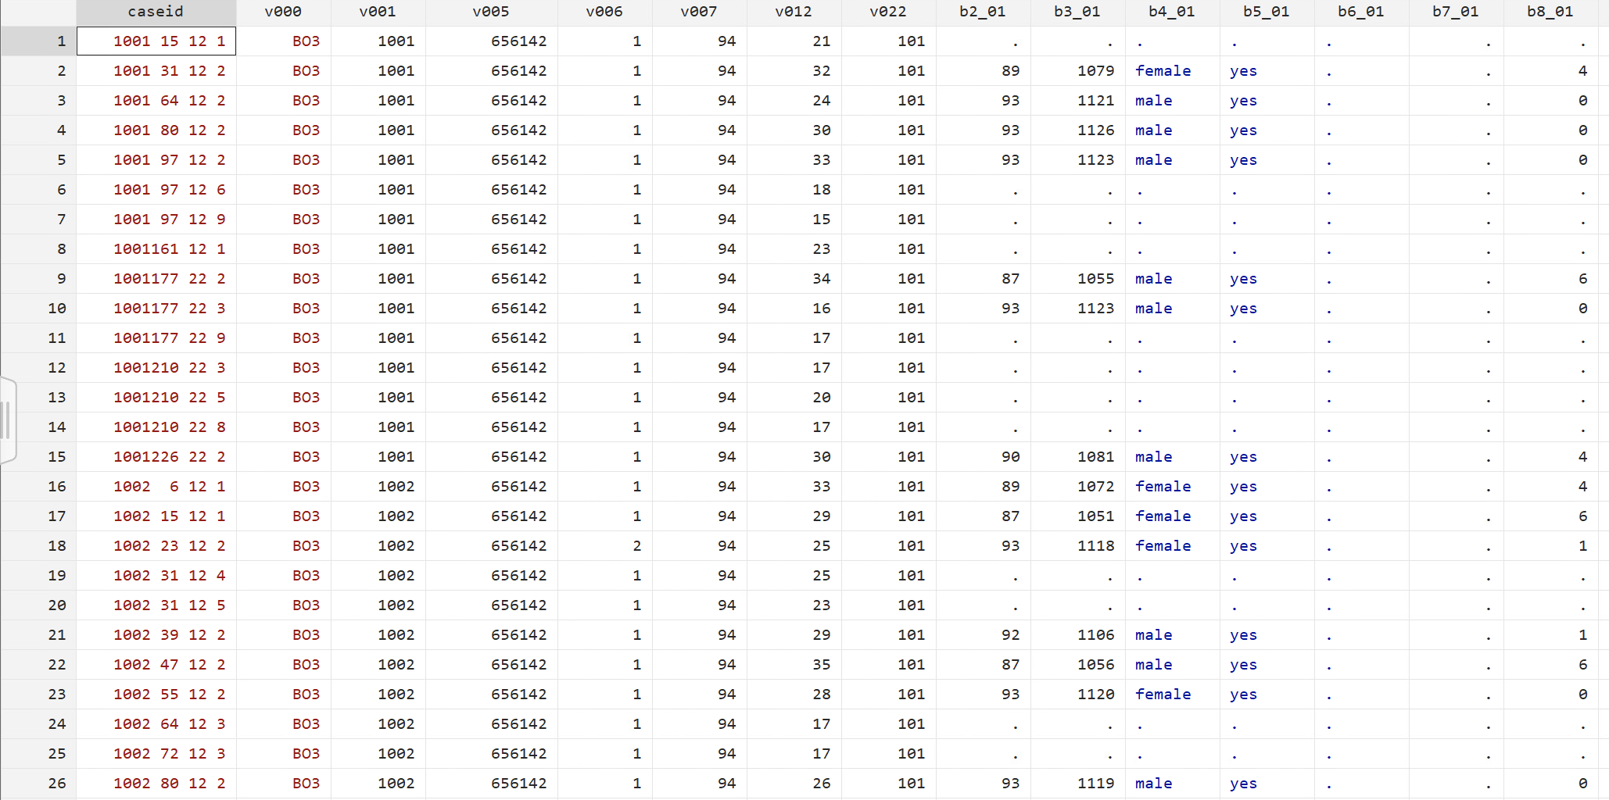
Master Dataset

Slide 15
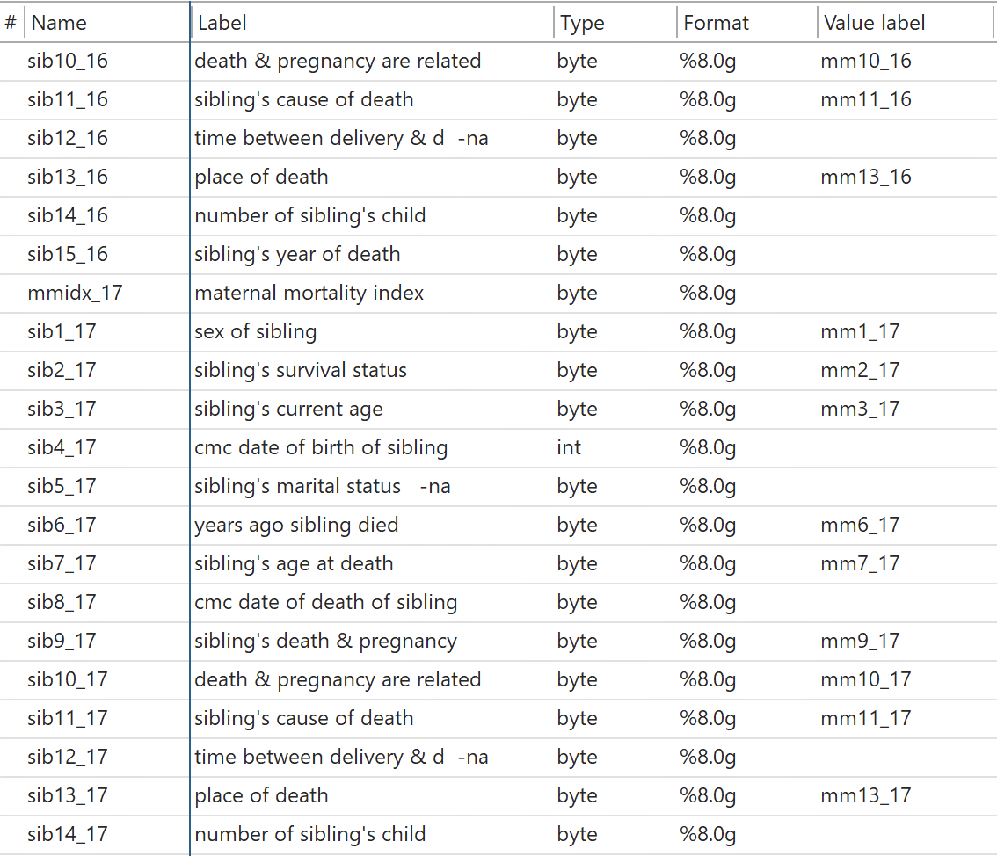
Renamed the variables in the Master Dataset
Notes:
Left is renamed; right is original name

Slide 16
Conclusion
Completed:
downloaded 493 public use datafiles
weeded through files to identify those with needed data
wrote new code that more efficiently appended files and that can be reused
Next steps:
Perform exploratory data analysis
Take away:
STATA
working with DHS data
team-work

